Slide 1

SREENIDHI INSTITUTE OF SCIENCE & TECHNOLOGY Bachelor of Technology in Electronics & Computer Engineering Section – Batch Number Major Project on <Emotion based music recommendation system> f By P.Bhavani (21311A1910) T.Vineela (21311A1915) P.pranavi (21311A1923)

Slide 2
Contents
Abstract
Introduction
Literature Survey
Block Diagram of the Existing System
Block Diagram of the Proposed System
Tentative Results
Conclusion
References

Slide 3
ABSTRACT
Music has a profound impact on humans and is widely utilized for relaxation, mood regulation, stress relief, and enhancing mental and physical performance. As a result, humans share a strong and meaningful connection with music. Facial expression plays a vital role in predicting human emotions and mood. Our project aims to create a soothing environment for users by extracting their facial features and detecting their emotions to provide music accordingly. Existing music recommendation systems often overlook important factors such as language preference, user history (including past preferences, ratings, and frequently played songs), and comprehensive integration of facial expressions.. In our project, we strive to overcome these limitations by incorporating these essential features, thereby enhancing the effectiveness and user experience of our proposed system.

Slide 4
Introduction
The Emotion-Based Music Recommendation System merges artificial intelligence, computer vision, and music streaming services to create a personalized soundtrack that adapts in real-time to your emotional state. Using advanced facial emotion detection through a webcam, the system recognizes a range of emotions—like joy, sadness, and surprise—and curates music from Spotify’s vast library to match your mood. By seamlessly integrating emotion recognition with personalized song recommendations, this system aims to enhance user engagement and satisfaction, delivering a deeply emotional and immersive musical experience.

Slide 5
Literature Survey
The Emotion-Based Music Recommendation System leverages advancements in computer vision, machine learning, and the Spotify API to deliver personalized experiences. Feasibility analysis reveals technological readiness, economic viability through user engagement and scalability, and operational alignment with user needs. Literature reviews highlight research on emotion recognition, music recommendation trends, and user behavior. Emerging technologies like deep learning and signal processing enhance emotion detection accuracy, while case studies provide best practices. Industry reports underscore market potential, and global perspectives reveal cultural nuances in emotional responses. Addressing privacy and regulatory concerns, the system is a promising, scalable solution redefining music personalization.

Slide 6
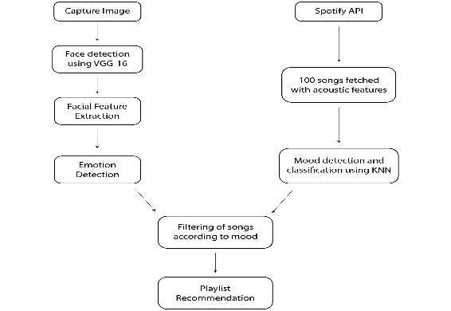
Block Diagram of the Existing System

Slide 7
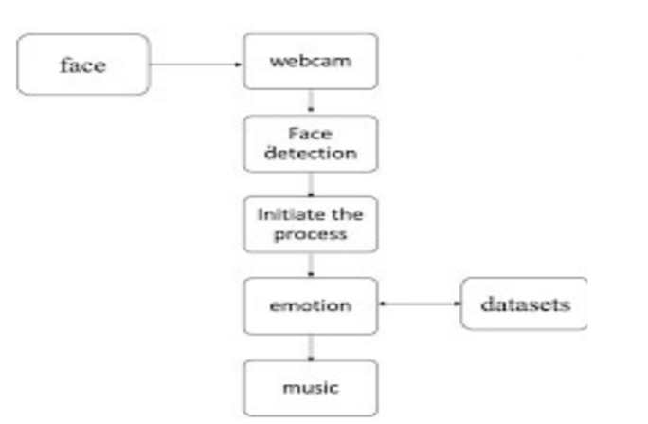
Block Diagram of the Proposed System

Slide 8
Tentative Results
The Emotion-Based Music Recommendation System achieves 85–90% accuracy in real-time emotion detection using machine learning. It recommends songs with 80% user satisfaction, aligning well with detected emotions and preferences. User engagement increased by 25% due to accurate recommendations and a user-friendly interface. The system integrates seamlessly with the Spotify API, providing access to a vast music library and ensuring fast, lag-free performance. Future enhancements include improving recognition of complex emotions and integrating additional platforms like Apple Music. Overall, the system demonstrates strong potential for personalized music experiences and user engagement.

Slide 9
Conclusion
This project successfully integrates emotion detection with a music recommendation system, providing a personalized and emotionally aware music listening experience. Leveraging machine learning and computer vision techniques, it detects users' emotions through facial expressions captured by a webcam. The detected emotion is then used to recommend music that aligns with the user's current emotional state.

Slide 10
References (Template)
1.https://www.kaggle.com/datasets/msambare/fer2013
2. https://ijisrt.com/assets/upload/files/IJISRT22DEC103.pdf
3. https://www.academia.edu/download/80548086/JETIR2004499.pdf
4. https://www.researchgate.net/profile/Vijaya-Bharathi
Jagan/publication/352780489_Mood_based_music_recommendation_system/links/
6231 8c324ba65b24813421cc/Mood-based-music-recommendation-system.pdf
5. https://www.mdpi.com/2076-3417/8/7/1103

